Slide 1
Prediction of mercury levels in water based on air, water, and land pollutants
Jenna Short
May 24nd, 2017

Slide 2


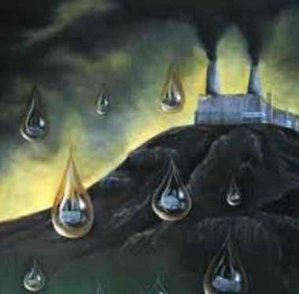
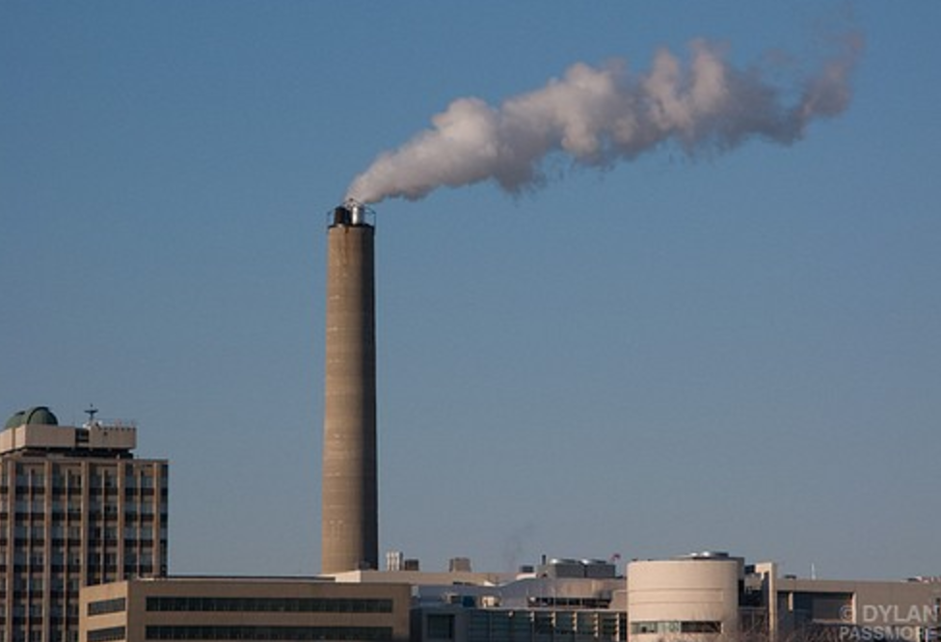
Overall Investigation
How do environmental features influence each other?

Slide 3
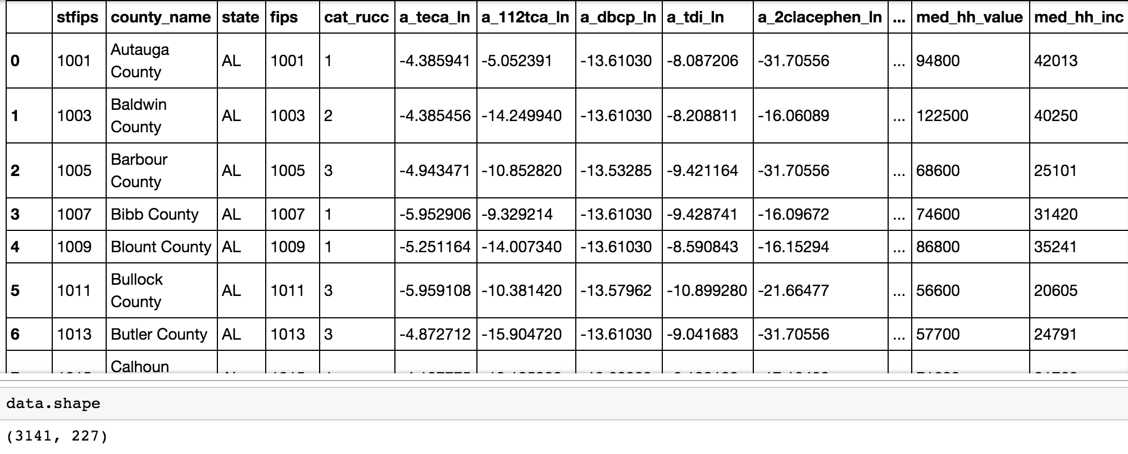
Environmental Quality Index
US Environmental Protection Agency based on several data sources (ex: National-Scale Air Toxics Assessment, National Atmospheric Deposition Program and National Contaminant Occurrance Database)
All data is temporally and geographically restricted
Contains land, water, air, and some population data
Averages from between 2000-2005

Slide 4
Mercury Levels in Water
Ingested by fish and bioaccumulates in both tissues of fish and humans that eat the fish. Can lead to:
Loss of peripheral vision
“Pins and needles” feelings
Lack of coordination of movement
Impairment in speech, hearing, walking
Muscle weakness
Removing and reducing mercury in water:
Filtration
Lime softening
Reverse osmosis
????
Finding out what pollutants increase mercury levels in water can help develop new/less expensive ways to lessen its detrimental impacts

Slide 5
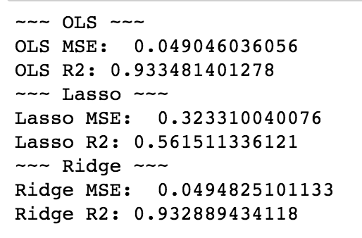
Approach
Shape of Data: 3141 rows, 227 columns
Dropped null data, dropped categorical data
Left all continuous features (left with 219 columns)
Fit standard, Lasso (drops irrelevant features) and Ridge (shrinks irrelevent coefficeints) models and use Lasso for feature selection
Notes:
You take out colinear variables because having both won’t explain any more of the variance so it’s useless to include it
I look at all continuous data

Slide 6
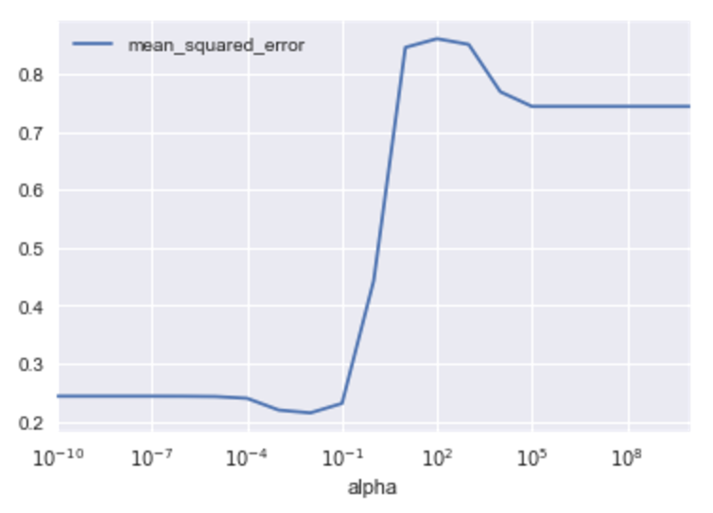
Grid Search
Best alpha to result in lowest MSE = .01
Error stays low for small alpha values and then increases at 1
Lasso features: 95 of 219 features are relevant
Lasso: minimal MSE 0.21448 at alpha = .01

Slide 7
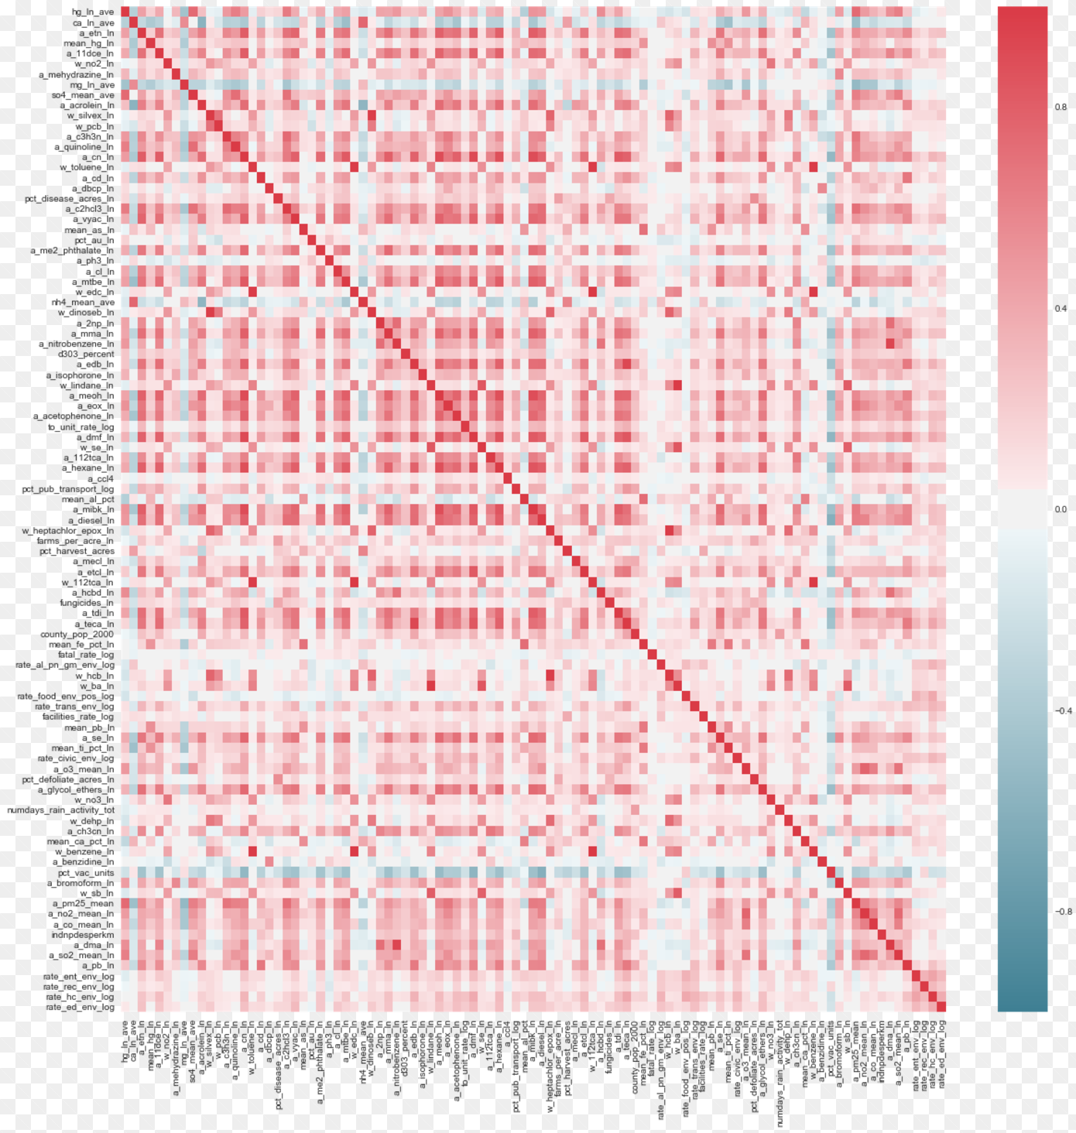
Correlation Matrix with 95 Lasso selected features

Slide 8
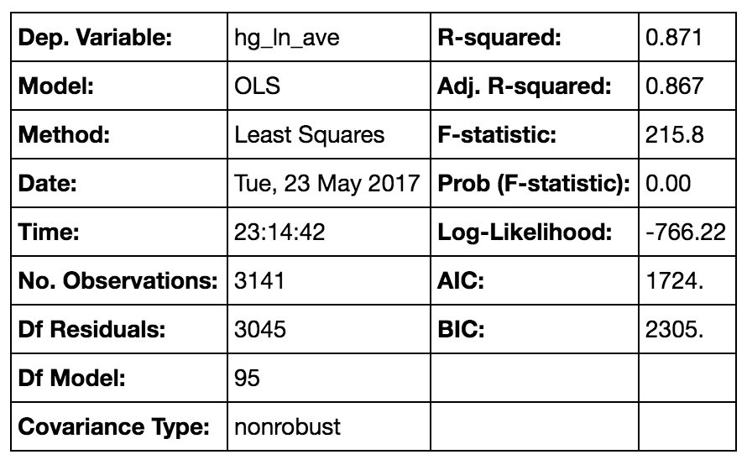
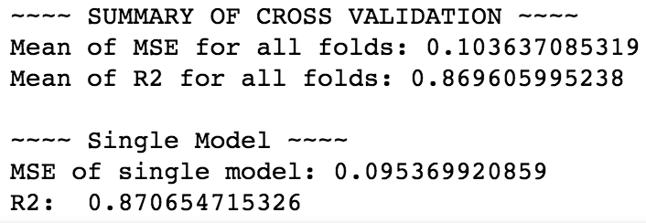
Ordinary Least Squares Regression
Most Significant:
Sulfate precipitation weighted mean (mg/L)
Calcium precipitation weighted mean (mg/L)
Ammonium precipitation weighted mean (mg/L)
Trichloroethylene (tons emitted per year)
Phosphine (tons emitted per year)
Mean level of titanium from sampled county sources (weighted percent)
Ethylene oxide (tons emitted per year)
Ozone (parts per million 5 year average)
Selenium (mg/L)
Mean level of lead from sampled county sources (ppm)
Sulfur dioxide (parts per billion 5 year average)

Slide 9
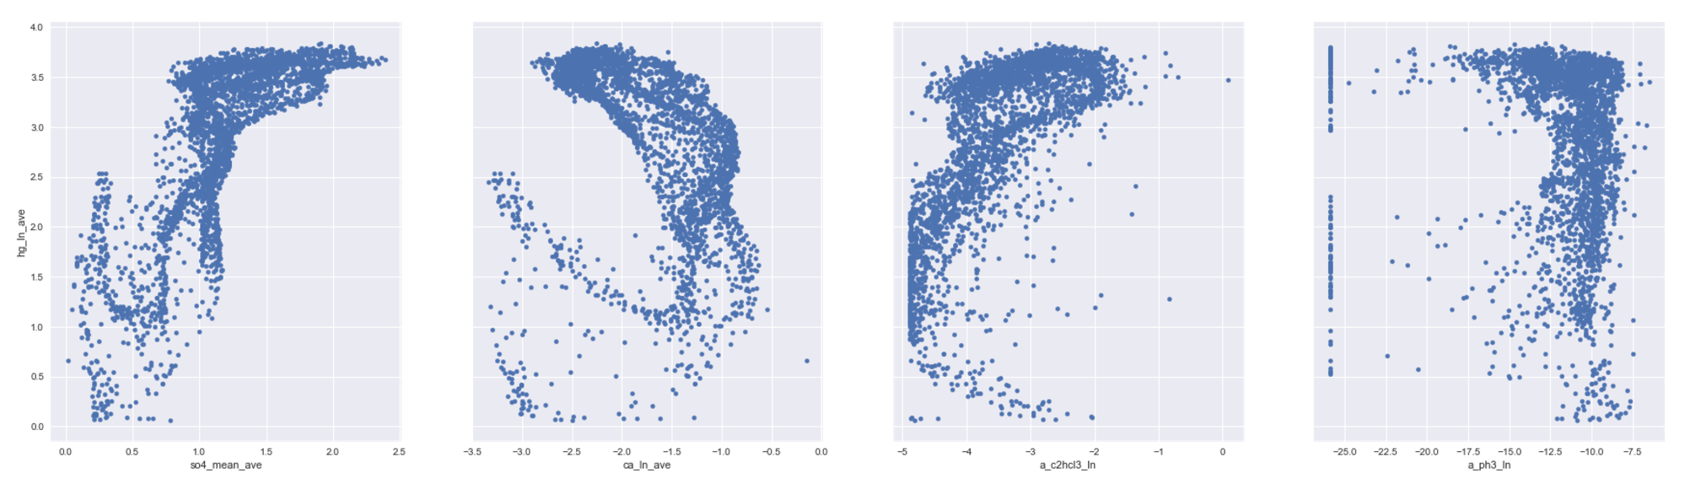
Most Significant Predictors of Increased Mercury Levels
Sulfate
precipitation weighted mean (mg/L)
p = 3.12e-81
Calcium (Ca) precipitation weighted mean (mg/L)
p = 7.14e-32
Trichloroethylene
(tons emitted per year)
p = 1.60e-24
Phosphine (tons emitted per year)
p = 5.12e-22

Slide 10
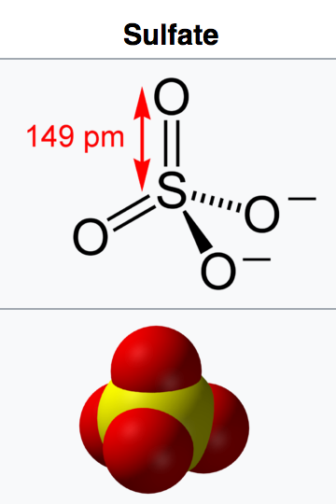
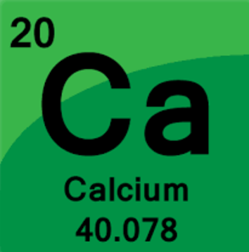
Conclusion
Most significant positive correlation: as mercury in water increases, sulfur in precipitation also increases.
Salt of sulfuric acid, increases the acidity of the atmosphere and form acid rain, used in fossil fuel and biomass combustion
Most significant negative correlation: as calcium precipitation increases, mercury in water decreases.
Calcium precipitation, can be used for desulfurization to eliminate harmful sulfates and nitrates
There were MANY contributing environmental factors that have a significant impact on the level of mercury in water, based on the 95 coefficients that were relevant in lasso regression.

Slide 11
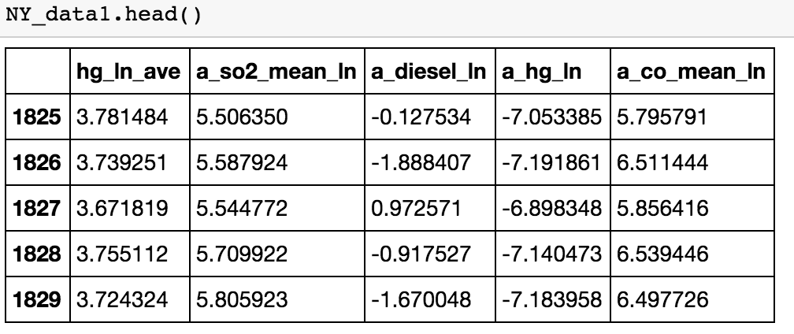
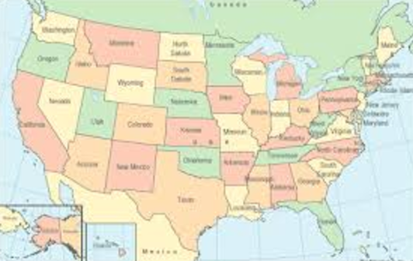
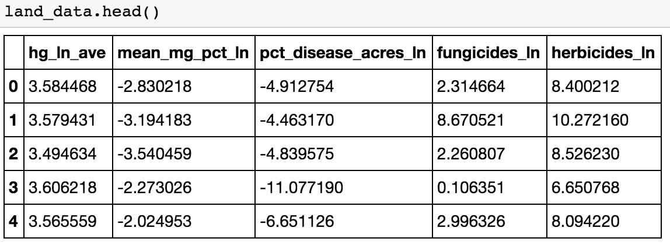
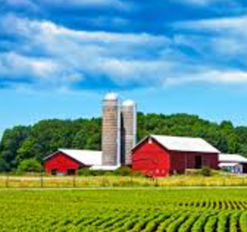
Next Steps
May help others determine the best way to lower mercury in water

Slide 12



Acknowledgements
FIRST AND FOREMOST:
Sri Kanajan and John Sabini
Everyone in the class for the help and great questions!
The EPA

Slide 13
References
https://www.epa.gov/mercury/health-effects-exposures-mercury
https://ehjournal.biomedcentral.com/articles/10.1186/1476-069X-13-39#MOESM2
http://people.uwec.edu/piercech/hg/mercury_water/drinkingwater.htm
https://www.wqa.org/learn-about-water/common-contaminants/mercury
https://www.health.ny.gov/environmental/chemicals/hsees/mercury/mercury_exposure_levels.htm

